Slide 1
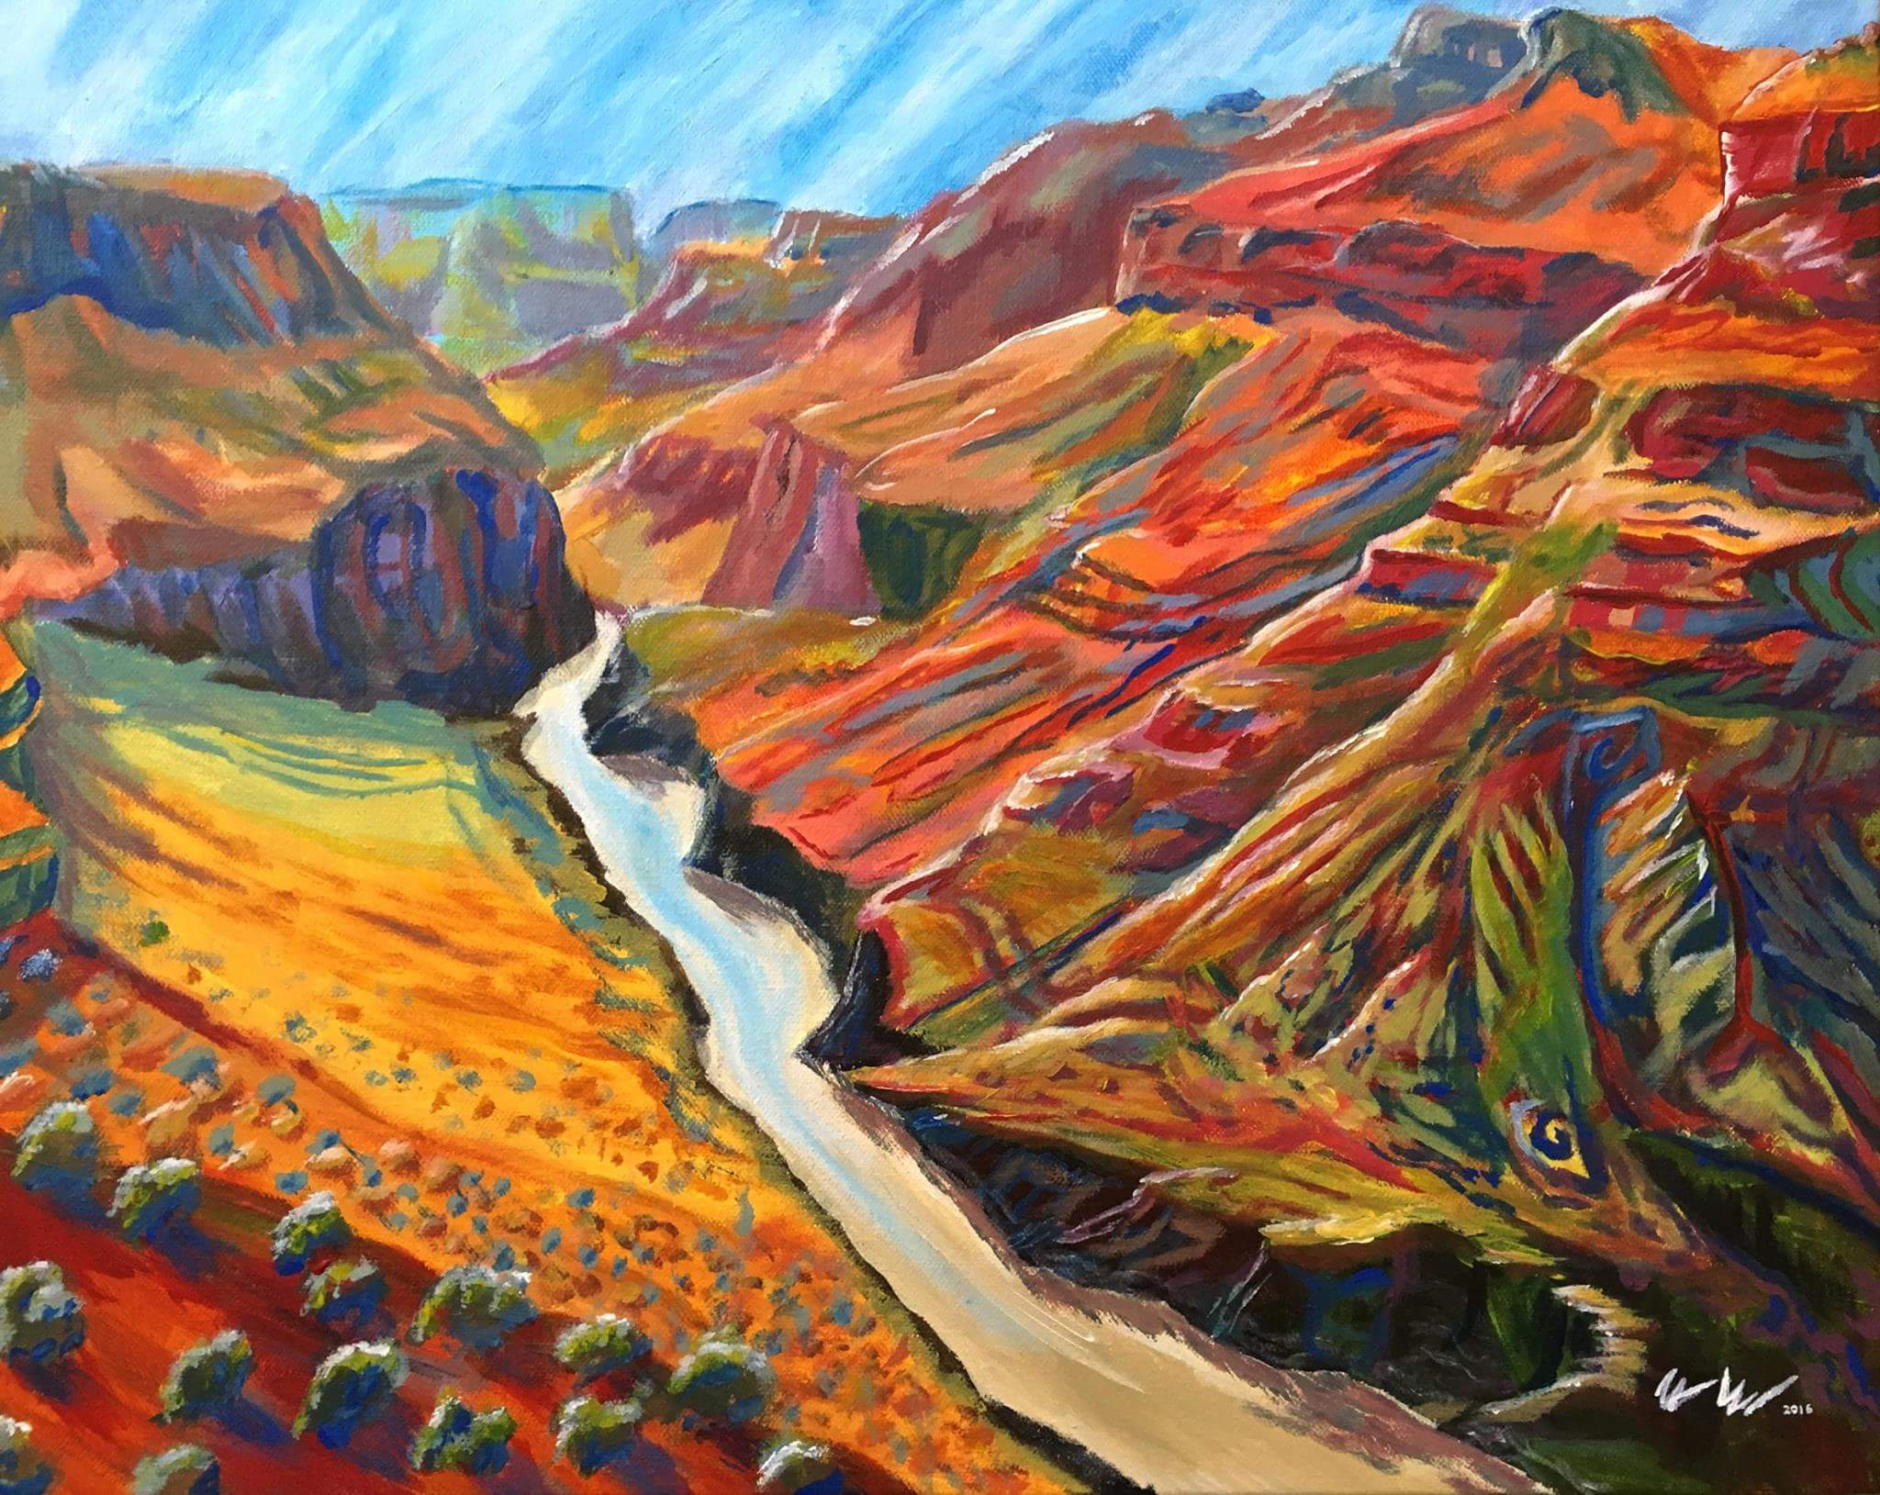




High Resolution Measurement of Landscape Change in Grand Canyon
Nat Bransky
School of Earth Sciences and Environmental Sustainablility: Northern Arizona University
Temuulen Sankey
School of Earth Sciences and Environmental Sustainablility: Northern Arizona University
Alan Kasprak
US Geological Survey

Slide 2
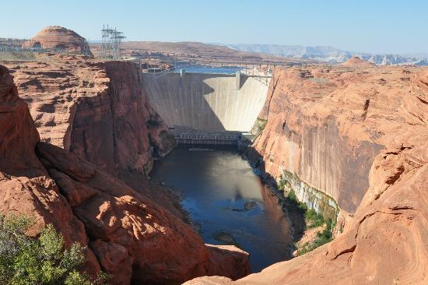
Glen Canyon Dam and Sediment Transport
Traps all sediment
from upstream
(Kent Frost, 1952)
(Steven Tharnstrom, 2003)

Slide 3
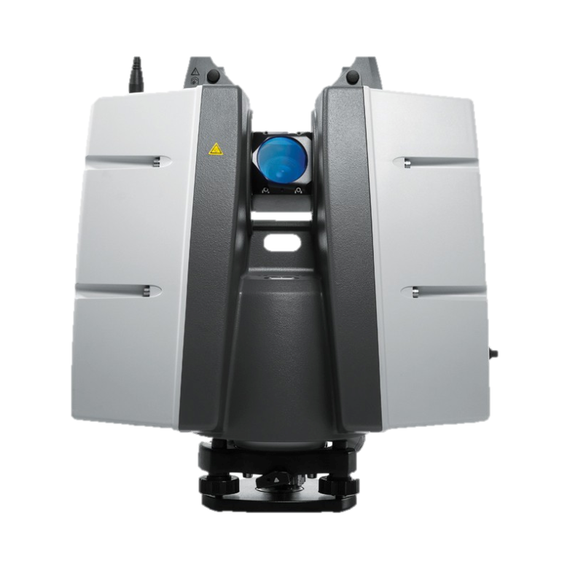
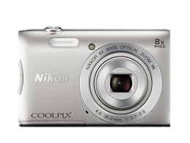
LiDAR and Structure from Motion
$100,000
$100

Slide 4
Project Goals
Assess geomorphic change at 2 sites along the Colorado River
Create digital elevation models for comparison analysis
Compare Structure from Motion DEMs to LiDAR DEMs
Develop a skillset in geospatial and remote sensing data analysis

Slide 5

Methods
Structure from Motion: extract elevation information from 2D photographs by generating 3D models and point clouds
How?
Feature Recognition: tracks objects from various angles throughout a photograph set
Cornell

Slide 6
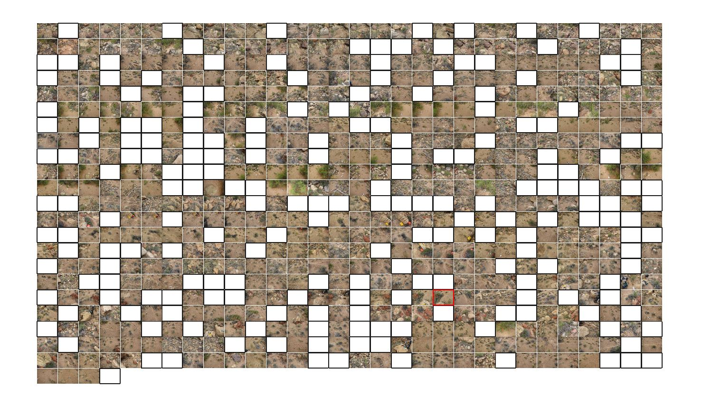
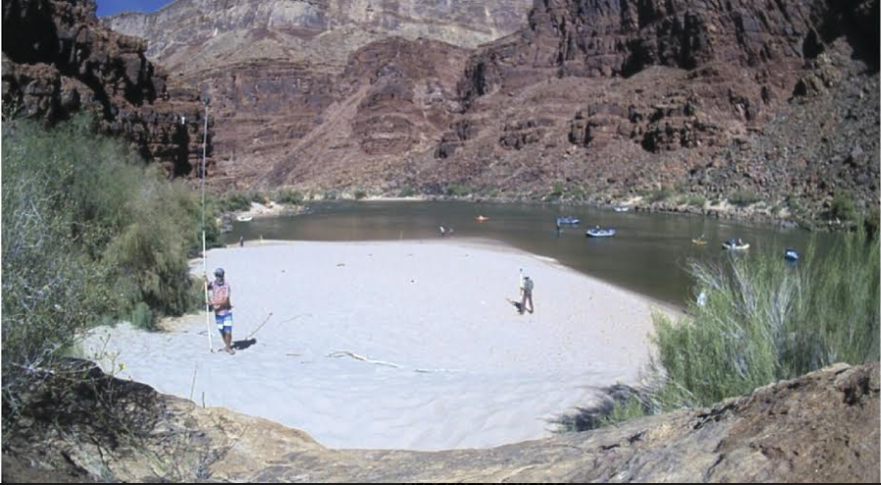
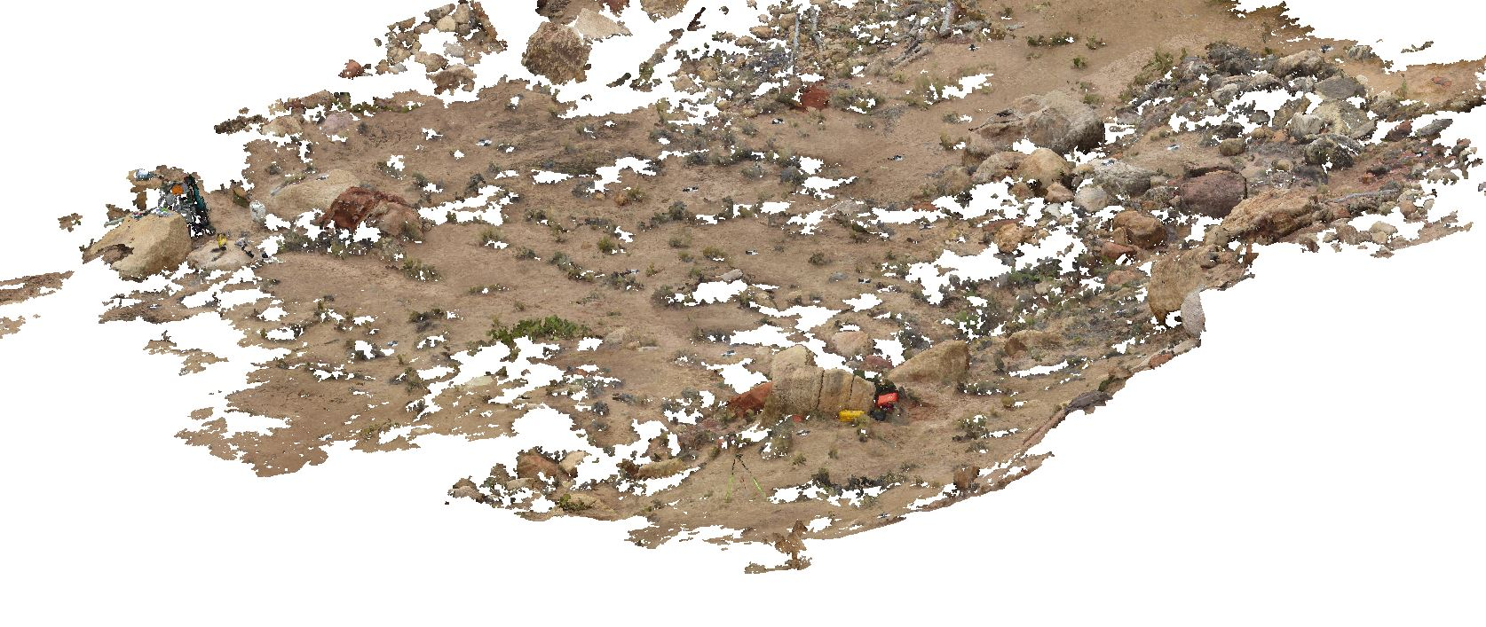
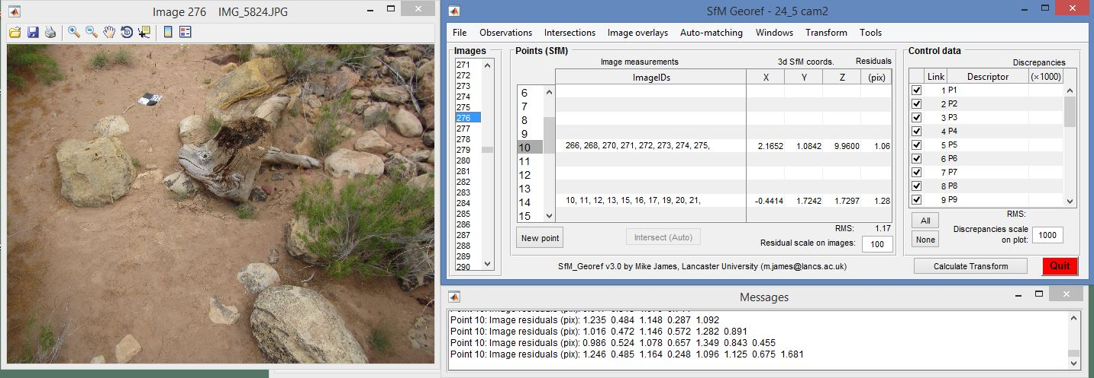
Methods: Pointcloud Generation
VisualSfM: Structure from Motion
SfM_georef

Slide 7
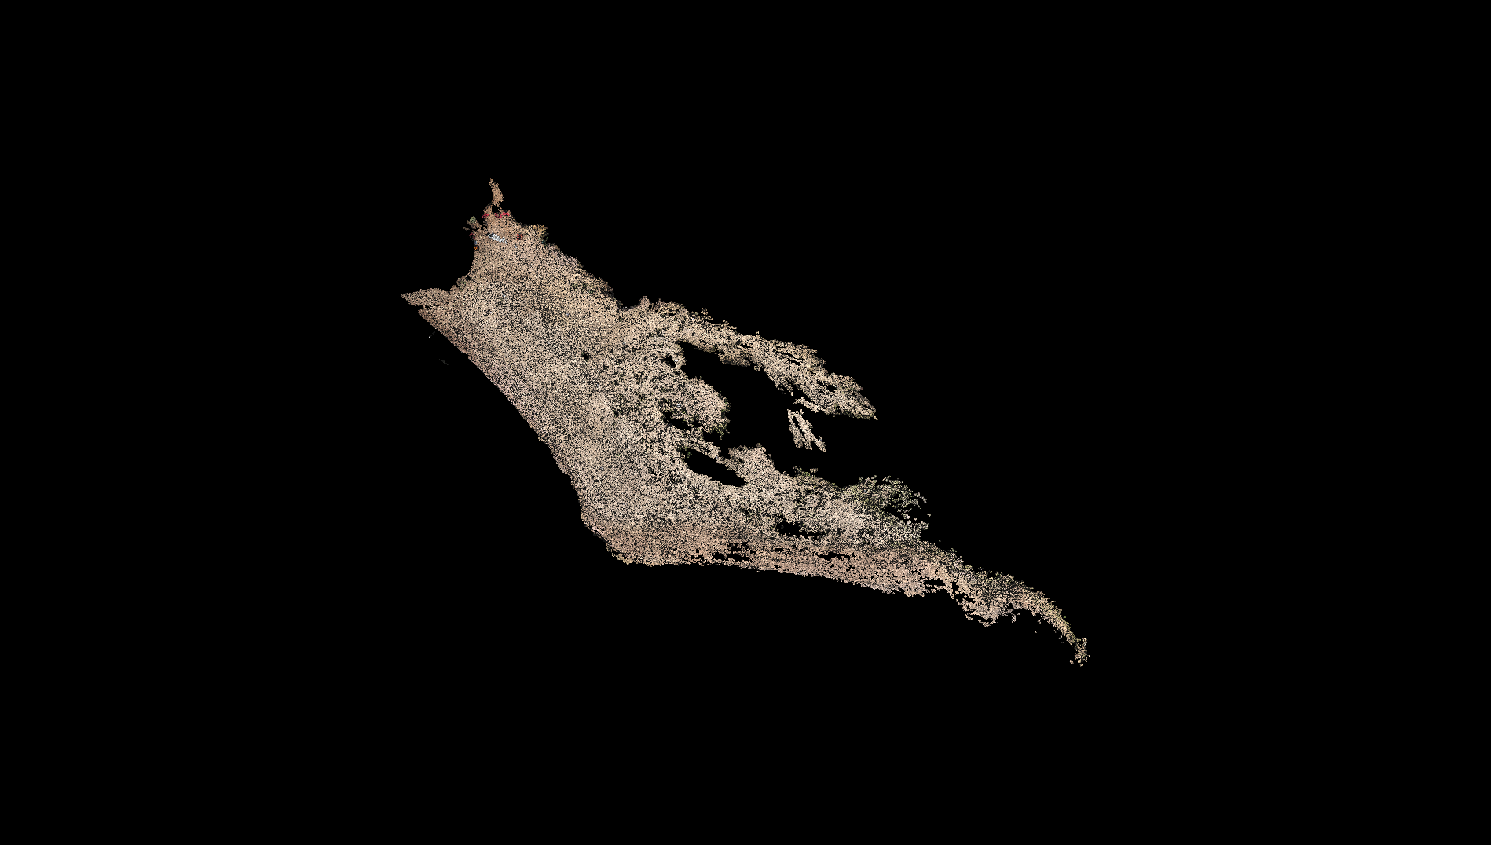
Methods: Pointcloud Cleaning
34,321,553 points
(CloudCompare)

Slide 8
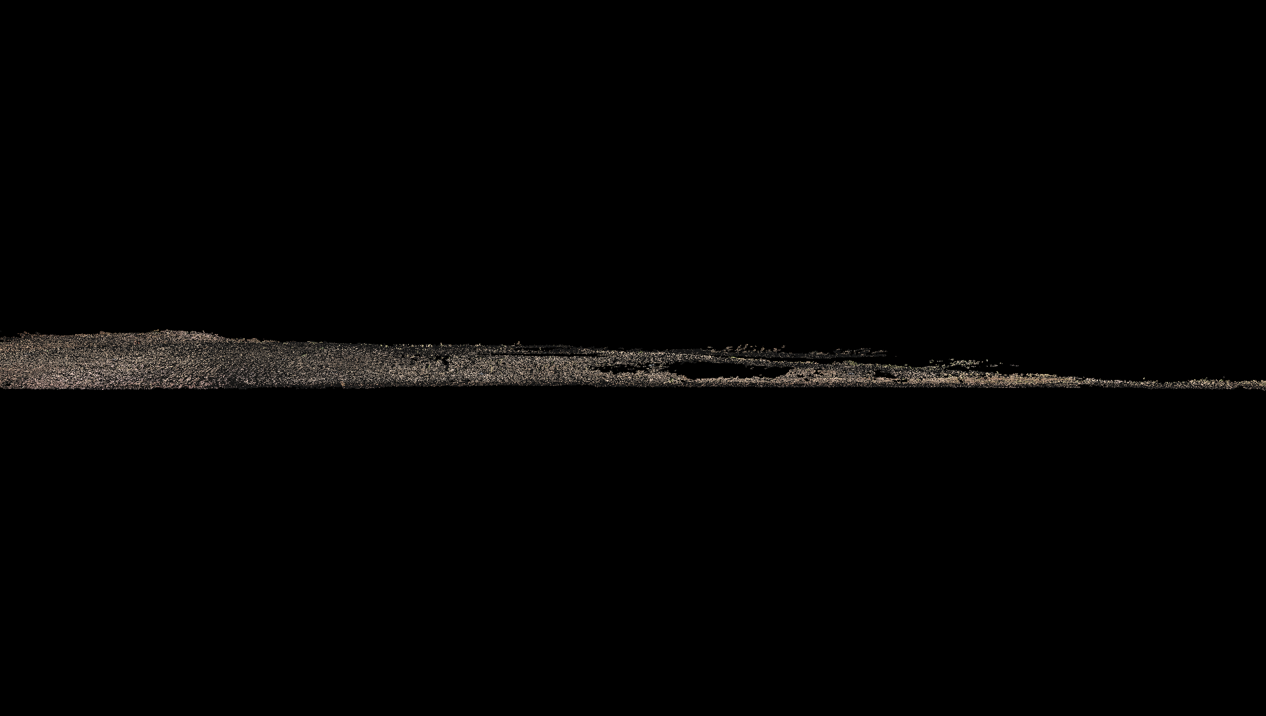
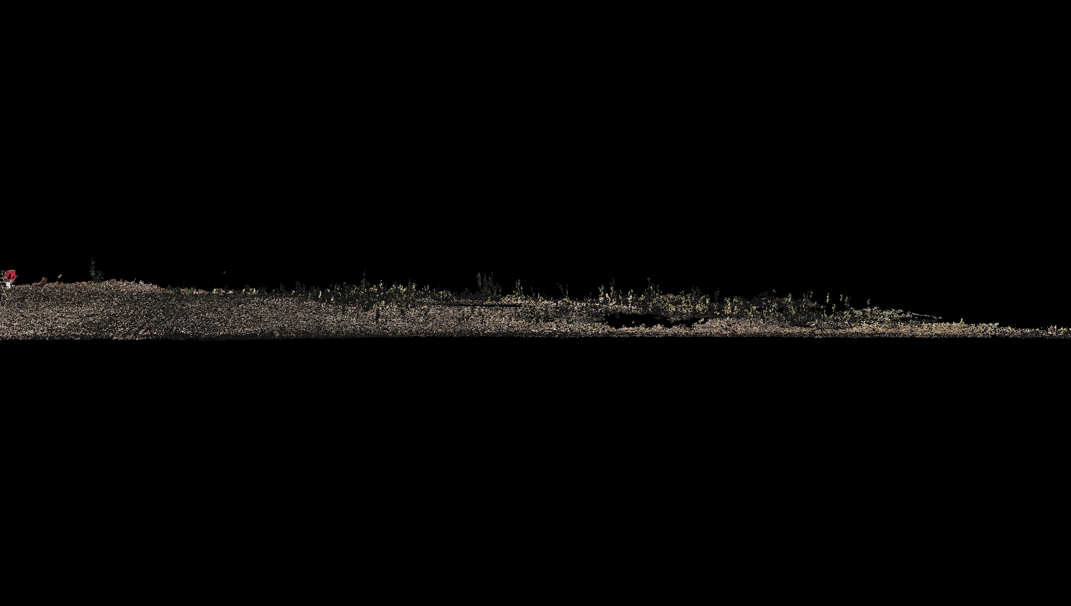
Methods: Pointcloud Cleaning
(CloudCompare)

Slide 9
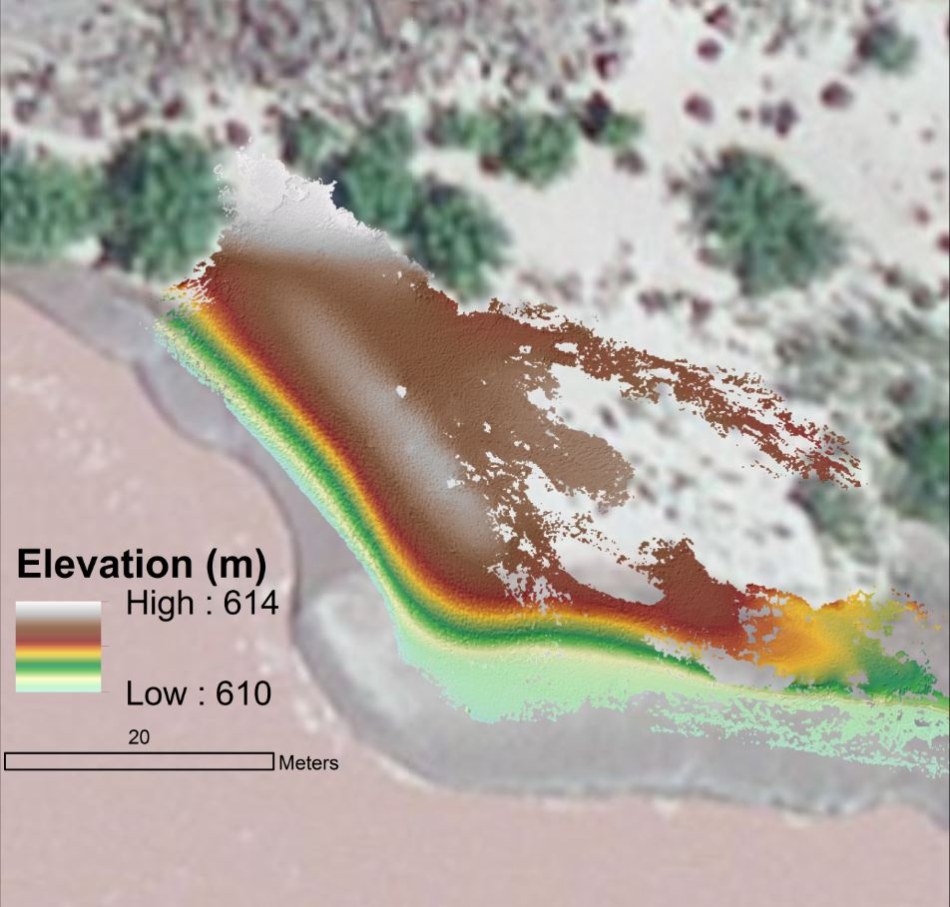
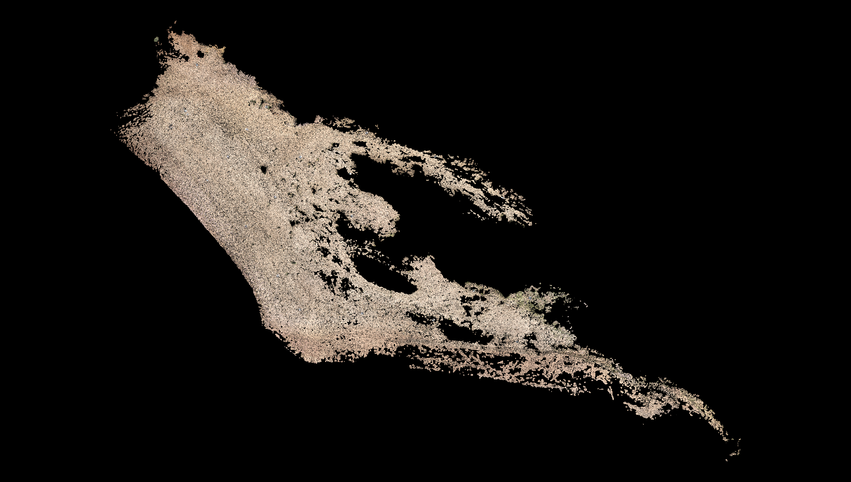
Digital Elevation Model

Slide 10
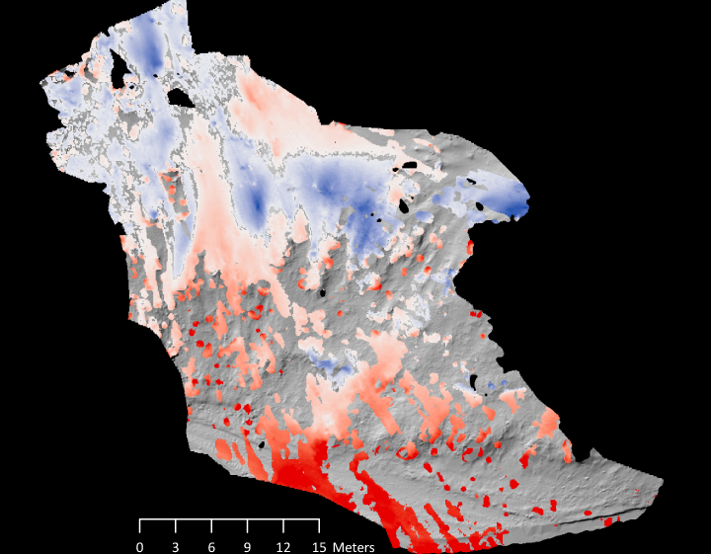

Results: Geomorphic Change Detection
5 cm
Deposition (+)
Erosion (-)

Slide 11
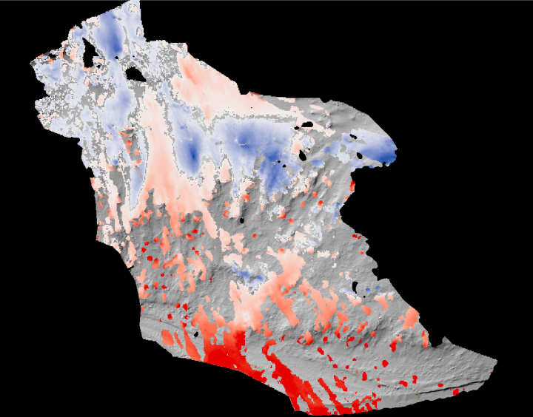
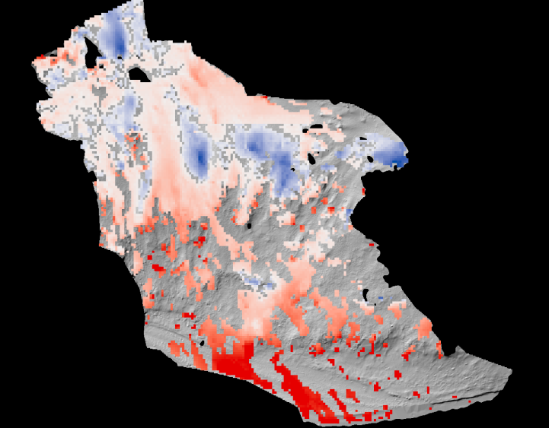
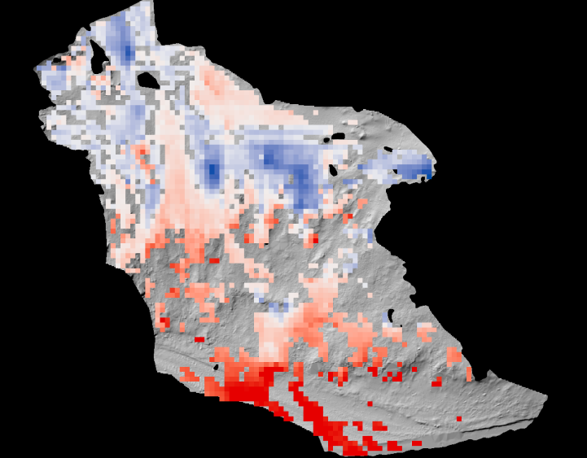
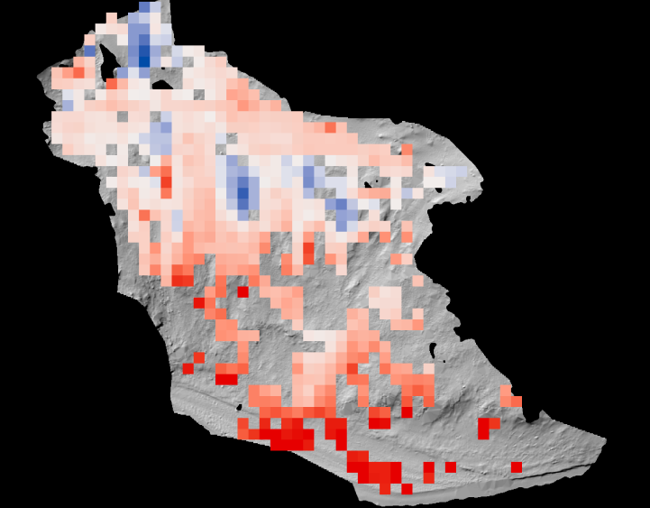
10 cm
25 cm
50 cm
1 m

Slide 12
Results: Geomorphic Change Detection
p=0.99

Slide 13
Results: Geomorphic Change Detection
R² = 0.99234

Slide 14
Results: Geomorphic Change Detection
R² = 0.47361

Slide 15
Results: Mechanistic Segregation

Slide 16
Conclusions
No significant difference (p=0.99) in changes detected by Structure from Motion vs LiDAR
As DEM resolution becomes coarser, changes (e.g erosion or deposition) are exaggerated
And mechanisms results differ
Future work: analyze DEMs from one more Colorado River site
Publish peer-reviewed scientific article

Slide 17
Acknowledgements
Dr. Teki Sankey: NAU SESES
Dr. Alan Kasprak: USGS
Josh Caster and Dr. Joel Sankey: USGS
Kathleen Stigmon and Dr. Nadine Barlow
NASA Space Grant Consortium

Slide 18
Questions?

